Slide 1
-by
Bhakti Pimparkar
1907037
-Guided by
Prof. Sachin Pukale
Pro data visualization using r and javascript

Slide 2
Introduction of Data Visualization
Data visualization is the graphical representation of information and data.
Data visualization tools and technologies are essential to analyze massive amounts of information
Data visualization helps to tell stories by curating data into a form easier to understand, highlighting the trends and outliers
Data visualization is also an element of the broader data presentation architecture (DPA) discipline, which aims to identify, locate, manipulate, format and deliver data in the most efficient way possible.

Slide 3
R and JavaScript
When creating data visualizations, R is an integral tool for both analyzing data and creating visualizations.
We will use R extensively through the rest of this book, so we had better level set first.
R is both an environment and a language to run statistical computations and produce data graphics.
JavaScript is the scripting language of the Web. JavaScript can be included in an HTML document either by placing script tags inline in the document or by linking to an external JavaScript document

Slide 4
Tools, Environment and Libraries
A data visualization tool is a form of software that’s designed to visualize data.
Splunk has seen a tremendous steady growth in interest over the last few years and for good reason. It is easy to use once it’s set up, scales wonderfully, supports multiple concurrent users, and puts data reporting at the fingertips of everyone.
D3.js which is short for Data-Driven Documents, is a JavaScript library for producing dynamic, interactive data visualizations in web browsers. It makes use of Scalable Vector Graphics (SVG), HTML5, and Cascading Style Sheets (CSS) standards.

Slide 5
Process Overview
We know some of the tools that are available to us to facilitate the analysis and creation of our charts. So now let’s look at the process involved.
  Identify a problem.
  Gather the data.
  Analyze the data.
  Visualize the data.

Slide 6
Identify a Problem
The very first step is to identify a problem we want to solve. The problem can be as profound and wide-reaching as figuring out why your bug backlog doesn’t seem to go down and stay down, to seeing what feature releases over a given period in time caused the most production incidents, and why.
Gather Data
If you are trying to solve a problem or tell a story around your own product, you would of course start with your own data likre our Apache logs, maybe your bug back log, maybe exports from your project tracking software.
Analyze Data
Analysis is the most crucial piece of creating data visualizations. It’s only through analysis that we can understand our data, and it is only through understanding it that we can craft our ideas and implement it.
Visualize Data
Once we’ve analyzed the data and understand it, and once we’ve created basic idea of the project that the data has within, then we can actually put the project idea into practice

Slide 7
Data Visualization using R
Basic Visualization
Advanced Visualization
Histogram
Bar/Line chart
Box plot
Scatter plot
Heat Map
Mosaic Map
Map visualization
3D Graphs

Slide 8
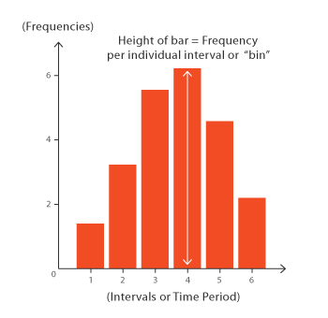
HISTOGRAM
A histogram is a chart that displays numeric data in ranges, where each bar represents how frequently numbers fall into a particular range.
Its basically a plot which breaks the data into bins and shows frequency distribution of these bins. You can change the breaks also and see the effect it has data visualization in terms of understandability.

Slide 9
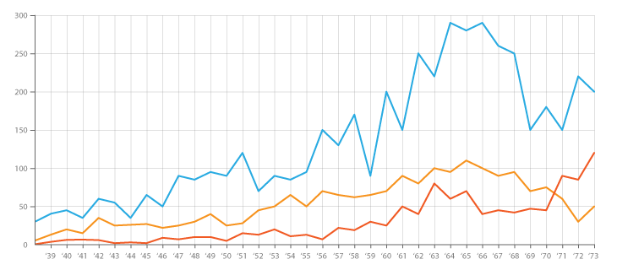
Line Chart
A line chart or line graph is a type of chart which displays information as a series of data points called 'markers' connected by straight line segments. It is similar to a scatter plot except that the measurement points are ordered (typically by their x-axis value) and joined with straight line segments.

Slide 10
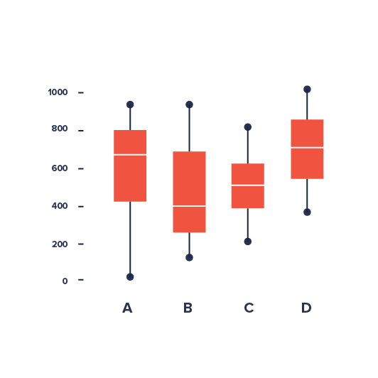
Box Plot
A boxplot is a convenient way of graphically depicting groups of numerical data through their quartiles. A box plot displays median, higher/lower quartiles and maximum/minimum. Outliers may be plotted as individual points.
The spacings between the different parts of the box indicate the degree of dispersion (spread) and skewness in the data, and show outliers. Box plots can be drawn either horizontally or vertically.

Slide 11
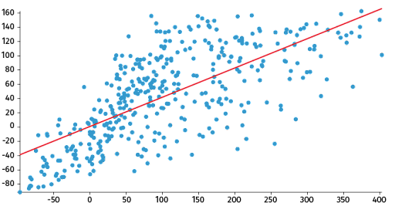
Scattered Plot
A scatter plot is a type of data visualization that shows the relationship between different variables. This data is shown by placing various data points between an x- and y-axis. Essentially, each of these data points looks “scattered” around the graph, giving this type of data visualization its name.

Slide 12
Importance of Data Visualization
The following are some use cases that stress the importance of data visualization:
Helping decision makers understand how the business data is being interpreted to determine business decisions.
Leading the target audience to focus on business insights to discover areas that require attention.
Handling large amounts of data in a pictorial format to provide a summary of unseen patterns in the data, revealing insights and the story behind the data to establish a business goal.
Revealing previously unnoticed key points about the data sources to help decision makers compose data analysis reports.

Slide 13
THANK YOU!

